Slide 1
A Phrase Mining Framework for Recursive Construction of a Topical Hierarchy
Date：2014/04/15
Source：KDD’13
Authors：Chi Wang, Marina Danilevsky, Nihit Desai,
Yinan Zhang, Phuong Nguyen, Thrivikrama Taula,
Jiawei Han
Advisor：Prof. Jia-Ling, Koh
Speaker：Shun-Chen, Cheng

Slide 2
Outline
Introduction
CATHY Framework
Experiment
Conclusions

Slide 3
Introduction
Jaguar
Car
Animal
Sport
Music
A high quality hierarchical organization of the concepts in
a dataset at different levels of granularity has many valuable applications such as search, summarization, and content browsing.

Slide 4
Introduction
recursively constructing a hierarchy of topics from a collection of content-representative documents.
content-representative documents： if it may serve as a concise description of its accompanying full document.

Slide 5
Introduction
Challenges：
1. Topical phrases that would be regarded as high quality by human users are likely to vary in length.
2. Globally frequent phrases are not assured to be good representations for individual topics.
VS
support vector machines
feature selection

Slide 6
CATHY Framework
Step1
Construct term co-occurrence network
Step2
Produce subtopic subnetworks
Extract candidate phrases
Rank topical phrases
Recursively apply step2 – 5 to each subtopic to construct the hierarchy
Step5
Step3
Step4

Slide 7
Outline
Introduction
CATHY Framework
Experiment
Conclusions

Slide 8
Problem formulation
Definition 1 : Phrase
an unordered set of n terms：
W：the set of all unique terms in a content-representative document collection.
Ex: mining frequent patterns = frequent pattern mining
Definition 2 : Topical Hierarchy
t0
t1
t2
t3
t4
par(t4) = t0
{Machine translation, statistical machine translation, word sense disambiguation, named entity}
ranking score for the phrases in topic t4

Slide 9
Problem formulation
Definition 3 : Topical Frequency
the count of the number of times the phrase is attributed to topic t
＊We use phrases as the basic units for constructing a topical hierarchy.

Slide 10
Construct term co-occurrence network
Root node o is associated with the term co-occurrence network constructed from the collection of content-representative documents.
a set of nodes W, a set of links E
Ex： words in content-representative documents = {A, B, C, D, E}
A
D
B
: a co-occurrence of the two terms(B, C) in a document
E
C
number of links 3, means 3 documents containing both D and E.

Slide 11
Clustering -EM algorithm
For every non-root node t ≠o,
we construct a subnetwork by clustering the term co-occurrence network of its parent par(t). has all of the nodes from
A
topic1
D
B
K child topics(K=3)
topic2
topic3
E
C
total link frequency between wi and wj：
estimate for z = 1 … k.

Slide 12
Clustering -EM algorithm
A
D
B
E
C
The probability of generating a topic-z link between wi and wj
is therefore
If repeat the generation of topic-z links for iterations
The probability of generating a topic-z link between wi and wj
= Bernoulli trial with success probability
When is large,

Slide 13
Clustering -EM algorithm
=

Slide 14
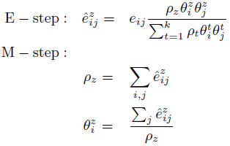
Estimating Topical Frequency
EM-Algorithm：
According to the learned model parameters , we can
estimate the topical frequency for a phrase
Normalizing

Slide 15
Topical Phrase Extraction
The goal is to extract patterns with topical frequency larger than some threshold minsup for every topic z.
1. mine all frequent patterns
Apriori
FP-growth
2. filtering by the topical frequency estimation
Problem：every subset of a frequent phrase is also a frequent phrase.
Completeness：
if not complete, it is a subset of a longer phrase, in the sense that it
rarely occurs in a document without the presence of the longer phrase.
ex: support vector machines
vector machines
some of these subphrases should be removed
Topical frequency estimation

Slide 16
Topical Phrase Extraction
Way of remove sunphrases：
For each topic, we remove a phrase P if there exists a frequent phrase P’,
such that . The remaining patterns
are referred to as γ-maximal patterns (0≦ γ ≦ 1)
Phrase | Support = fz(P)
A | 4
B | 4
C | 3
AB | 3
AC | 2
BC | 3
ABC | 2
If P = C,
γ = 1 => fz(P’)≧fz(P)
Remove C! => 1-maximal patterns: closed pattern
γ = 0 => fz(P’)≧0
Remaining patterns = ABC
=> 0-maximal patterns: maximal pattern
γ = 0.5 => fz(P’)≧0.5 * fz(P)
Remaining patterns = ABC
=> 0.5-maximal patterns
: all of the γ-maximal phrases of a topic z

Slide 17
Ranking Criteria
4 Criteria for judging the quality of phrases：
Coverage：
cover many documents within that topic.
ex: in IR topic
information retrieval
cross-language information retrieval
Phraseness：
it is only frequent in documents belonging to that topic and not frequent in documents within other topics.
ex: in Databases topic.
query processing
query

Slide 18
Ranking Criteria
Purity：
they co-occur significantly more often than the expected chance co-occurrence frequency.
ex: in Machine Learning topic
active learning
learning classification
Completeness：
ex: support vector machines
vector machines

Slide 19
Phrase Ranking -for each topical phrases
：the number of documents that contain at least one frequent topic-z phrase.
Coverage：
Phraseness：
Purity：
Ranking function：
All topics

Slide 20
Outline
Introduction
CATHY Framework
Experiment
Conclusions

Slide 21
Experiment
Datasets
DBLP：a set of titles of recently published computer science papers in the areas related to DB, DM, IR, ML, NLP. 33,313 titles consisting of 18,598 unique terms.
Library：titles of books in 6 general categories. 33,372 titles consisting of 3,556 unique terms
Methods for comparison
SpecClus
hPAM
hPAMrr
CATHYcp: only considers the coverage and purity criteria (γ =1, ω =0)
CATHY: minsup=5, γ=ω=0.5

Slide 22
Experiment - subtree of output rooted at Level2
Work with DBLP dataset.
Topic：Information Retrieval
One of nodes in L2

Slide 23
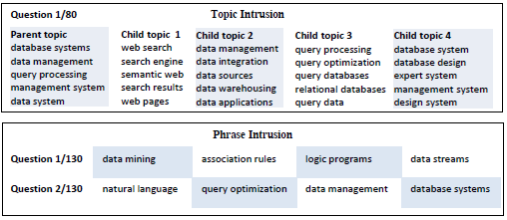
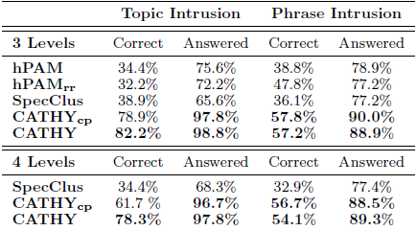
Experiment - User Study
Work with DBLP dataset.

Slide 24
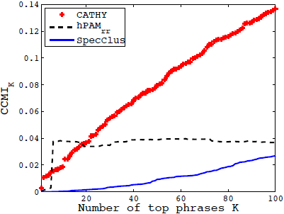
Experiment - predict book’s category
Work with Library dataset.

Slide 25
Outline
Introduction
CATHY Framework
Experiment
Conclusions

Slide 26
Conclusions
Design a novel phrase mining framework to cluster, extract and rank phrases which recursively discovers specific topics from more general ones, thus constructing a top-down topical hierarchy.
Shifting from a unigram-centric to a phrase-centric view.
Validate the ability to generate high quality, human-interpretable topic hierarchies.

